Slide 1
Patent Eligibility Under § 101
Tenth Global Network Summit
Alan J. Kasper
September 27, 2018
The views shown in these slides are the speaker‘s personal views, and do not represent the views of Sughrue Mion PLLC

Slide 2
Overview of §101
Three hurdles to patentability
§101: Patentable subject matter
§102: Novelty
§103: Non-obviousness
§101 is a threshold issue of patent eligibility
Decided as a matter of law by the court
Can be decided at the beginning of litigation, thereby ending litigation quickly, before incurring much expense
Can be a weapon to defend against “troll” law suits

Slide 3
Overview of §101
35 U.S.C. §101
Whoever invents or discovers any new and useful process, machine, manufacture, or composition of matter, or any new and useful improvement thereof, may obtain a patent therefor, subject to the conditions and requirements of this title.
Except: Laws of Nature, Natural Phenomena, & Abstract Ideas
Policy Rationale: Avoid Pre-emption
Preempt use of the basic tools of science & technology in all fields
Impede rather than promote innovation
Goes against the primary object of patent law

Slide 4
Alice Corp. v. CLS Bank U.S. Supreme Court
Issue: Is a computer-implemented scheme for mitigating “settlement risk” (i.e., the risk that only one party to a financial transaction will pay what it owes) by using a third party intermediary, eligible for a patent?
Unanimous Decision (June 19, 2014): NO!
Holding: An intermediated settlement is an abstract idea, and merely requiring generic computer implementation fails to transform the claims to eligible subject matter.

Slide 5
Alice Analysis
Apply Two Part Test from Mayo v. Prometheus
Determine if the claims at issue are directed to one of the patent ineligible concepts (e.g., an abstract idea)
If so, consider each claim element individually and in combination with other claim elements to determine if the additional elements are "transformative"
Often described as a search for an "Inventive Concept“
Invention must provide “significantly more” than the abstract idea itself
Note: Prior to this case the above test applied only to determining patentability of Laws of Nature

Slide 6
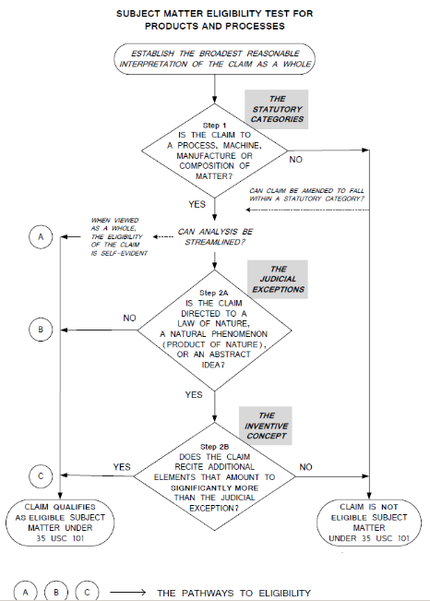
MPEP 2106:
Patent Subject Matter Eligibility

Slide 7
Predicted Danger from Unpatentability
"If all of these claims, including the system claims, are patent-ineligible, this case is the death of hundreds of thousands of patents, including all business method, financial system and software patents as well as many computer-implemented and telecommunications patents."
CLS Bank Int'l v. Alice Corp. Pty. Ltd., 717 F.3d 1269, 1292-313 (Fed. Cir. 2013) (Moore, dissenting)

Slide 8
Patent Eligibility at the Federal Circuit
Post-Alice: over 70 rulings on patent-eligibility
Digitech Planet Bingo † buySAFE Ultramercial DDR Holdings Ambry
Content Extraction Allvoice †
OIP Tech. Sequenom Internet Patents
IV v. Cap. One Bank Versata *
Vehicle Intelligence †
Mortgage Grader In re Smith * Genetic Tech.
In re Brown * †
Enfish
TLI Comms.
BASCOM
Rapid Lit. Mgmt. Shortridge † Lendingtree † Electric Power Group In re Chorna * †
TDE Petroleum †
McRO
Affinity Labs. v. Amazon Affinity Labs. v. DirecTV IV v. Symantec FairWarning
Synopsys Amdocs Tranxition † Ameranth *
Trading Tech. v. CQG † Evolutionary Intel. † Smartflash †
IV v. Cap. One Financial IV v. Erie Indemnity I
Thales Visionix In re Salwan * † Clarilogic † Coffelt †
Mentor Graphics West View Research † RecogniCorp Easyweb †
Credit Acceptance Cleveland Clinic Prism Tech. † Audatex †
Visual Memory
Return Mail
Secured Mail Smart Systems Two-Way Media
IV v. Erie Indemnity II † Inventor Holdings Finjan v. Blue Coat Core Wireless
Move v. Real Estate Alliance †
Berkheimer v. HP Ziuli v. Google LLC * † Aatrix Software
Automated Tracking Sol. †
Exergen Corp. v. Kaz USA †
IV v. Symantec Corp. †
Vanda Pharmaceuticals
SAP America (May 15, 2018)
Source: Chart of subject matter eligibility court decisions (updated May 3, 2018) https://www.uspto.gov/patent/laws-and-regulations/examination-policy/subject-matter-eligibility
Bold text indicates decision identifying claims as eligible
Green text indicates decision identifying natural product, natural phenomenon, or law of nature
* Case appealed from USPTO † Non-precedential decision
(Rule 36 affirmances not shown)

Slide 9
Patent Eligibility at the Federal Circuit

Slide 10
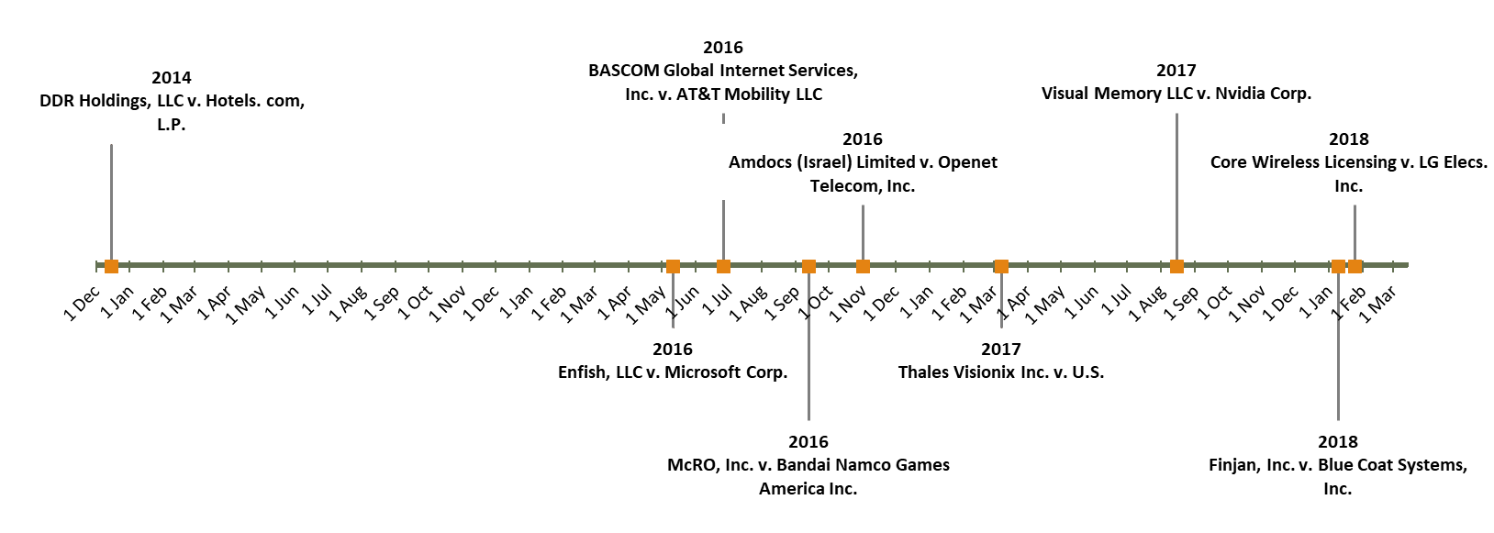
Patent Eligibility at the Federal Circuit
Patent eligibility for software inventions is a recent trend

Slide 11
Post-Alice Decisions: Basis for Eligibility of Inventions Step 1 – no abstract idea Step 2 – significantly more
Case | Step 1 | Step 2
DDR Holdings v. Hotels.com | ✓ | ✓
Enfish, LLC v. Microsoft Corp. | ✓
Bascom Global Internet Svcs. AT&T Mobility, LLC |  | ✓
McRO, Inc. v. Bandai Namco Games | ✓
Amdocs (Israel) Ltd. V. Openet Telecom, Inc. |  | ✓
Thales Visionix Inc. v. United States | ✓
Visual Memory LLC. v. Nvidia Corporation | ✓
Finjan, Inc. v. Blue Coat Systems, Inc. | ✓
Core Wireless Licensing v. LG Elecs. Inc. | ✓
Berkheimer v. HP Inc. |  | ✓
Aatrix Software, Inc. v Green Shades Software, Inc. |  | ✓

Slide 12
Patent Eligibility at the PTAB
Source: Anticipat Research

Slide 13
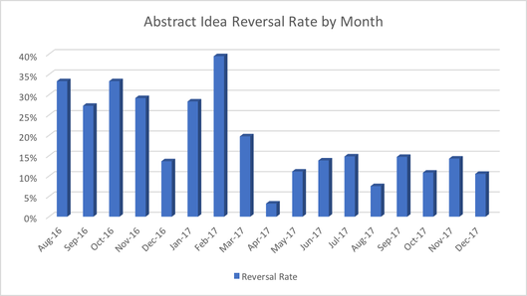
Patent Eligibility at the PTAB
Consistent decline of reversals
Source: Anticipat Research

Slide 14
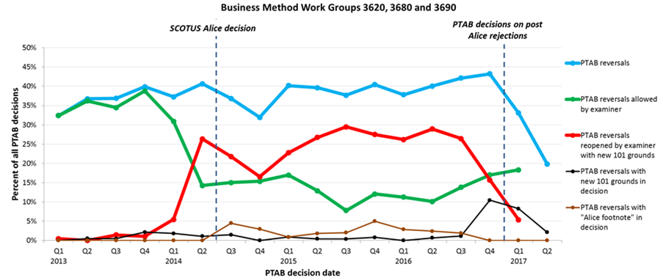
Patent Eligibility at the PTAB
Very sharp decline of Examiner reversals
Source: BilskiBlog

Slide 15
Joint AIPLA/IPO Legislative Proposal
Eligible Subject Matter
(a) Whoever invents or discovers, and claims as an invention, any useful process, machine, manufacture, composition of matter, or any useful improvement thereof, shall be entitled to a patent therefor, subject only to the conditions and requirements set forth in this title.
Sole Exceptions to Subject Matter Eligibility
(b) A claimed invention is ineligible under subsection (a) if and only if the claimed invention as a whole (i) exists in nature independently of and prior to any human activity or (ii) is performed solely in the human mind.
Sole Eligibility Standard
(c) The eligibility of a claimed invention under subsections (a) and (b) shall be determined without regard to:
(i) the requirements or conditions of sections 102, 103, and 112 of this title;
(ii) the manner in which the claimed invention was made or discovered; or
(iii) whether the claimed invention includes an inventive concept

Slide 16
Examination @ USPTO
The MPEP was updated (January 2018)
Chapter 2100: Eligibility guidance
Chapter 706.03(a): Subject matter eligibility rejections
But there are more CAFC decisions since the MPEP revisions (Finjan, Core Wireless, Berkheimer, etc.)

Slide 17
USPTO Guidance
Numerous Memorandum
June 7, 2018 (Vanda)(administering step)
April 19, 2018 (Berkheimer)(burden of proof on Examiner)
April 2, 2018 (Finjan, Core Wireless)
November 2, 2016 (McRO, Bascom)
July 14, 2016 (Rapid Litigation, Sequenom)
May 19, 2016 (Enfish, TLI)
December 16, 2014
June 25, 2014 (Alice)
Initially unclear due to poor guidance from Mayo and Alice
Inconsistently application throughout USPTO
Courts not bound by USPTO Guidance but find exceptions

Slide 18
Proposed USPTO Guidance
Director Iancu Comment at the September 2018 IPO Meeting:
IPO and AIPLA have proposed new statutory language. Should Congress be interested in moving forward with hearings or legislation, the USPTO would help. But the process takes time.
USPTO cannot wait. Examiners need additional guidance now, and so do patent applicants, patent owners, and the public. The issue must be promptly addressed.
The USPTO is contemplating revised guidance to help categorize the exceptions—and to name them—and instruct examiners on how to apply them..
For greater predictability, the contemplated guidance would do two primary things:
First, it would categorize the exceptions based on a synthesis of the case law to date.
Second, if a claim does recite a categorized exception, the guidance would instruct examiners to decide if it is “directed to” that exception by determining whether such exception is integrated into a practical application.

Slide 19
Proposed USPTO Guidance is Pro-Patent
A First Component:
The exceptions to patentability should capture only those claims that the Supreme Court has said remain outside the categories of patent protection, despite being novel, nonobvious, and well-disclosed, specifically, the “basic tools of scientific and technological work,” such as:
pure discoveries of nature, such as gravity, electromagnetism, DNA, etc.—all natural and before human intervention (Myriad)
fundamental mathematics like calculus, geometry, or arithmetic per se (Bensen)
basic “methods of organizing human activity,” such as fundamental economic practices like market hedging and escrow transactions (Bilski and Alice)
pure mental processes such as forming a judgment or observation.

Slide 20
Proposed USPTO Guidance
A First Component:
In a first step, the USPTO would first look to see if the claims are within the four statutory categories: process, machine, manufacture, or composition of matter. This is not new—they always do this.
If statutory, the USPTO would then check whether the claims recite matter within one of the judicial exceptions, categorized as above. This is the new approach.
If the claims do not recite subject matter falling into one of the disallowed categories, then the 101 analysis is essentially concluded and the claim is eligible.

Slide 21
Proposed USPTO Guidance
A Second Component:
In a second step, if the claims do recite subject matter in one of the excluded categories, the Supreme Court instructed that the USPTO must decide whether the claims are “directed to” those categories.
The proposed new guidance is based on Supreme Court jurisprudence, taken together, that effectively allows claims that include otherwise excluded matter as long as that matter is integrated into a practical application, distinguishing mere principles from practical applications of such principles.
If the claim "integrates" the exception into a practical application, then the claim is not “directed to” the prohibited matter and is eligible.
This analysis does not include questions about “conventionality,” which are addressed in Alice Step 2. That is, it does not matter if the “integration” steps are arguably “conventional”; as long as the integration is into a practical application, then the 101 analysis is concluded.
Without integration, the USPTO would move to a third component for analysis.

Slide 22
Proposed USPTO Guidance
A Third Component:
In a third step, the analysis would be conducted under step 2 of Alice in view of the guidance from Berkenheimer (2018).
The invention would be evaluated for its advance in a technology or a computer, looking for "significantly more" than the abstract idea .
While patent eligibility under 35 U.S.C. § 101 is “ultimately an issue of law that [is] reviewed de novo,” the inquiry may contain underlying issues of fact.
Whether something is well-understood, routine, and conventional to a skilled artisan at the time of the patent is a factual determination.
Whether a particular technology is well-understood, routine, and conventional goes beyond what was simply known in the prior art.
The mere fact that something is disclosed in a piece of prior art, for example, does not mean it was well-understood, routine, and conventional – it may convey "significantly more."

Slide 23
Post-Berkheimer
Well-Understood, Routine, Conventional Activity:
An Examiner should conclude that an element (or combination of elements) represents well-understood, routine, conventional activity only when the Examiner can readily conclude that the element(s) is widely prevalent or in common use in the relevant industry.
The question of whether additional elements represent well-understood, routine, conventional activity is distinct from patentability over the prior art under 35 U.S.C. §§ 102 and 103.
"[w]hether a particular technology is well-understood, routine, and conventional goes beyond what was simply known in the prior art. The mere fact that something is disclosed in a piece of prior art, for example, does not mean it was well-understood, routine, and conventional."

Slide 24
Post-Berkheimer
Requirements for Rejections Under Step 2B analysis:
(1). A citation to an express statement in the specification or to a statement made by an applicant during prosecution that demonstrates the well-understood, routine, conventional nature of the additional element(s).
(2). A citation to one or more of the court decisions discussed in MPEP § 2106.05(d)(II) as noting the well-understood, routine, conventional nature of the additional element(s).
(3). A citation to a publication that demonstrates the well-understood, routine, conventional nature of the additional element(s).
(4). A statement that the examiner is taking official notice of the well-understood, routine, conventional nature of the additional element(s).

Slide 25
Berkheimer Guidance
Examiner Consideration of Additional Elements Individually and in Combination:
Additional elements must be evaluated individually and in combination to determine whether a claim includes significantly more than a judicial exception.
Must also consider the combination of elements
To support a rejection of a claim where the examiner takes the position that additional elements A and B are routine, the combination of A and B must be shown to represent well-understood, routine, conventional activity in the pertinent art.

Slide 26
Summary
The proposed guidance would categorize the exceptions based on a synthesis of the case law to date.
The proposed guidance would base patentability of a claim that recites a categorized exception on whether the claim is “directed to” that exception by determining whether such exception is integrated into a practical application.
The proposed guidance will establish a meaningful dividing line between 101 and 102/103 analysis. A fully “conventional” yet patent-eligible claim may still be unpatentable as obvious. It is better to address such a claim with obviousness law.
The proposed guidance does not deny claims as ineligible merely because they are broad or functionally-stated or result-oriented. These issues are addressed under Section 112.

Slide 27
Thank You!
Alan J. Kasper
Partner
Sughrue Mion PLLC
akasper@sughrue.com
http://www.sughrue.com/akasper

