Slide 1
IP Protection of AI in Europe
Dr Saiful Khan
Sep 2018

Slide 2
Overview
The importance of artificial intelligence
Protecting IP of artificial intelligence in Europe
Trends
Notes:
The bulk of this presentation is devoted to patenting, with the first and final topics included to give relevant context and ideas. By the end of the presentation it is hoped that issues relating to patenting AI, alongside the merits / drawbacks of alternative forms of IP protection, will be better understood.

Slide 3
The importance of artificial intelligence

Slide 4
What is artificial intelligence (AI)?
Artificial intelligence
Machine learning
Sensing
Neural networks
Natural language processing
Analytics
Deep learning
Prescriptive
Machine vision
Sound recognition
Predictive
Descriptive
Notes:
Artificial intelligence (AI), the study and design of intelligent agents, covers a broad range of tools/approaches and underlying processes.
The concepts, technologies and capabilities highlighted in the above graphic are intended to give an impression of what AI can in general encompass, the development of each being intimately linked with the development of advanced computer hardware and access to large datasets (“big data”).
For example:
AI analytics (analytics in general concerning the systematic analysis of data) allows us to better understand what has happened (i.e.; descriptive analytics) but can also be used to inform: predictive analytics indicating what could happen; prescriptive analytics indicating (e.g., to businesses) a best course of action.
Machine learning concerns the ability of computer systems to learn without explicit programming or input. Here, neural networks and natural language processing each reflect forms of biological behaviour and understanding/synthesis of natural language data respectively.
Awareness of the scope of AI is instructive when understanding what may constitute an AI invention and how it can subsequently be protected.

Slide 5
What’s affected by artificial intelligence?
Notes:
In a word, everything: healthcare; quality of life; optimisation of networks; the list goes on. Even patent offices and patent firms!
Although AI is not new per se, with approaches such as text recognition commonplace in today’s society, the pace of change and the increased possibility of realising artificial general intelligence is.
Important to remember that AI is an enabling technology, similar to electricity or the internet. As a major field of the forth industrial revolution, artificial intelligence and artificial intelligence inventions have the potential to revolutionise every sector of society.
What is the potential economic impact of AI? PwC estimate a ~ 15% potential contribution by AI to the global economy by 2030, some $15 trillion, a contribution that encompasses benefits to productivity, personalisation and quality of life.

Slide 6
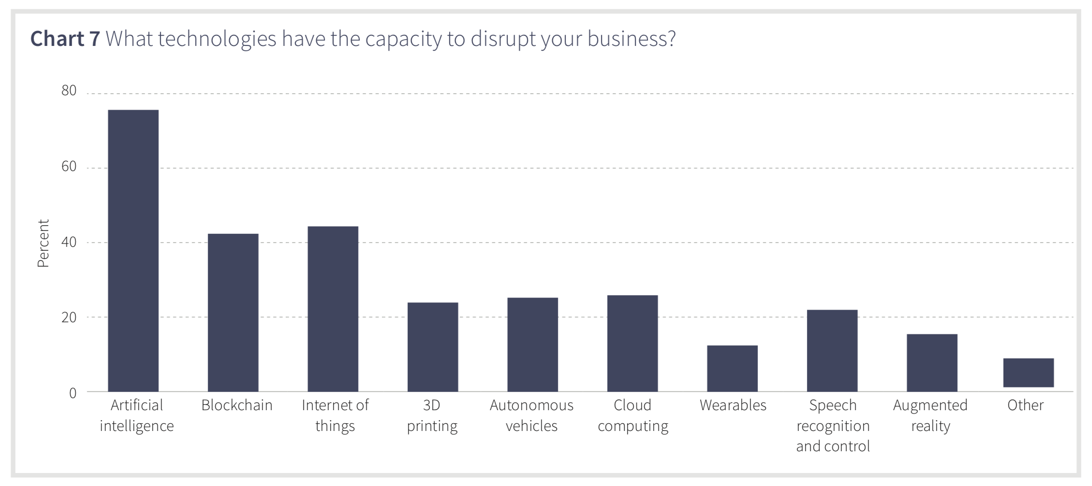
Business awareness
Cipher IP Strategy Report 2018
Notes:
Awareness of any technology with a capacity to disrupt the status quo is the first step toward developing the right business strategies for continued growth and success. As highlighted above, AI is acknowledged as a technology with disruptive capacity.
Cipher’s IP Strategy Report is recommended reading for providing a current overview of disruptive technology and IP issues. For AI, pertinent issues include increased investment in licenses and R&D, mergers, acquisitions and collaborations / partnerships. From an IP perspective, patents are generally the right approach for protecting investments in R&D outputs.

Slide 7
Protecting IP of AI in Europe

Slide 8
Patentable inventions
“European patents shall be granted for any inventions, in all fields of technology, provided that they are new, involve an inventive step and are susceptible of industrial application.”
Art. 52(1) EPC
Notes:
Although this presentation focuses on patenting in Europe, the underlying principles are common to other patent systems. The following slides will consider issues relating to the central requirements for patentability, granted patents and IP in general.

Slide 9
Eligibility – Excluded subject matter
Mathematical methods as such are not inventions (e.g., Art. 52(2)(a) EPC, §1(2)(a) Patents Act 1977).
Is AI a mathematical method?
Yes but…
Structured data, data formats, model training (e.g., machine learning), robotics etc. are of a technical nature.
Notes:
The correct answer, arguably, is ‘sometimes’. Knowing when an AI concept is more than just a mathematical method and has technical character is the first step towards determining patent protection eligibility.
The same can be said for other non-inventions such as rules and methods for performing mental acts.
Case law relating to computer-implemented inventions and mathematical methods, areas that are more developed that AI inventions, provide relevant guidance on what may or may not be allowed.
Note: Whilst data as mere presentation of information is ineligible subject-matter, structured data generally is.

Slide 10
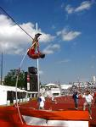
The “two-hurdles” approach at the EPO
Excluded Subject Matter
Inventive step
Technical character a requirement of the EPC.
Claims can nevertheless mix technical and non-technical features.
Easy to overcome
Only the features of a claim that contribute to its technical character are used for assessment of inventive step.
Hard to overcome
Notes:
From patent eligibility to novelty and inventive step. The “two-hurdles” approach is central to the EPO’s guidelines for computer-implemented inventions (CII). Knowing how to overcome each hurdle will maximise the chances of a successful prosecution.
The CII guidelines in their entirety provide one of the most useful resources from a patent office on seeking patent protection for AI inventions (see also the JPO’s Examination Guidelines pertinent to IoT related technologies); its framework is well established, used by all technical fields and followed by the EPO in a predictable manner. The next update to these guidelines is anticipated to include examples specific to AI.

Slide 11
EPO – Current Approach example
A data processing system comprising;
a receiver configured to receive a message comprising sales data of a plurality of products;
a processor configured to analyse the sales data to identify a sales pattern using a statistical technique; and
identify a subset of the plurality of products using the sales pattern.
Is it technical?
If so, passes the excluded subject matter test and we move to novelty/inventive step.

Slide 12
EPO – Current Approach example
A data processing system comprising;
a receiver configured to receive a message comprising sales data of a plurality of products;
a processor configured to analyse the sales data to identify a sales pattern using a statistical technique; and
identify a subset of the plurality of products using the sales pattern.
Ignore any non-technical subject matter when assessing obviousness
Sales data is non-technical
Statistical technique is just a mathematical method
The plurality of products is business related

Slide 13
Inventive step
Technical character
Non-technical character
Claim
Unable to support presence of inventive step
Used to assess inventive step
Notes:
With credit to the EPO, the above figure straightforwardly communicates how the EPO examines a claim for inventive step, given that, ultimately, the features contained within the claim will either be technical or not. If there’s one slide to remember from this presentation it’s this one. Note that the scope of the claim, which could be considered as the size of the circle, may overlap with the closest prior art. Claim features that exist within the overlap area cannot be used to assess inventive step because they would fall at the first hurdle of novelty.
Other possibilities:
If there is a surprising effect from using AI in the particular application, then that can help to get a patent granted. Second, if the AI processing is new in its own right and is not limited to any particular application, then that can help too.

Slide 14
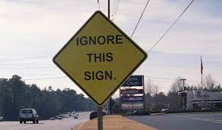
Inventive Step – non-technical features
Notes:
The correct answer, arguably, is ‘sometimes’. Knowing when an AI concept is more than just a mathematical method and has technical character is the first step towards determining patent protection eligibility.
The same can be said for other non-inventions such as rules and methods for performing mental acts.
Case law relating to computer-implemented inventions and mathematical methods, areas that are more developed that AI inventions, provide relevant guidance on what may or may not be allowed.
Note: Whilst data as mere presentation of information is ineligible subject-matter, structured data generally is.

Slide 15
Key aspects of disclosure
Legal requirements:
Claims define the subject-matter for which protection is sought.
Must be clear, concise and supported by the description.
Sufficient disclosure of algorithms and specialized functions.
Avoid “black boxes” and buzz words if these place an undue burden on working the invention.
Notes:
Claim terms will be assessed by a patent office to their technical meaning; e.g. neural network…. “smart” meter in IOT – what is smart?
With reference to slide 4 and the related discussion, it can be appreciated that AI terminology may not necessarily have an obvious technical meaning. Care must be taken when crafting the claims to use technical terms that are established in the (relevant) field.

Slide 16
Example patent
RECURRENT NEURAL NETWORKS FOR DATA ITEM GENERATION (EP 3 054 403 B1)
A system implementing a deep recurrent attentive writer neural network architecture for data item generation.
Combines a spatial attention mechanism that mimics the foveation of the human eye with a sequential variational autoencoding framework that enables an iterative construction of complex images.
The system may be used to generate high quality images that cannot be distinguished from real data with the naked eye.
Notes:
The proprietor of this patent is Google. Foveation, or foveated imaging, reflects variations in resolution across an image according to one or more fixation points. In the human eye, the fovea is responsible for sharp central vision.
Possible further applications, as disclosed in the patent:
Image classification tasks
Image inpainting paintings
Image segmentation tasks.
Background on neural networks:
Neural networks are machine learning models that employ one or more layers of nonlinear units to predict an output for a received input. Some neural networks include one or more hidden layers in addition to an output layer. The output of each hidden layer is used as input to the next layer in the network, i.e., the next hidden layer or the output layer. Each layer of the network generates an output from a received input in accordance with current values of a respective set of parameters.
Note to self: Slide text taken from para. [0007].

Slide 17
Example patent – description & claim language
Description
Claim
By iteratively constructing scenes through an accumulation of modifications emitted by a decoder included in the architecture, each of which is observed by an encoder included in the architecture, the system implementing a deep recurrent attentive writer neural network architecture may selectively attend to particular parts of a scene whilst ignoring others, thus improving the visual structure of a constructed image.
A neural network system implemented by one or more computers, the neural network system comprising:
an encoder neural network, wherein the encoder neural network is a recurrent neural network that is configured to, for each input data item processed by the encoder neural network and at each time step of a plurality steps:
receive a glimpse captured by reading from the input data item,
receive a decoder hidden state vector of a decoder neural network for the preceding time step, and
process the glimpse…;
a decoder neural network, wherein the decoder neural network…..
Excerpt from EP 3 054 403 B1
RECURRENT NEURAL NETWORKS FOR DATA ITEM GENERATION
Notes:
Can point out key passages to reinforce earlier message. The intention is to give the audience an opportunity to read and hopefully appreciated the content of a claim from an AI patent.
Note to self: Description taken from para. [0009].

Slide 18
Awareness of the skilled person
Relevant to inventive step and disclosure (sufficiency & clarity).
Skilled in the field.
Average knowledge and ability.
Not creative, yet involved in technology development.
Can conduct routine work and experimentation, including the use of AI tools.
May comprise a team.
Notes:
Awareness of what the skilled person can and cannot do is valuable in general when drafting claims. Here, the forth and fifth points are perhaps the most interesting when considering AI inventions. The availability and ability of general-purpose AI will have a large influence on what constitutes obviousness in the field. There is probably an element of subjectivity here; nonetheless it is worthwhile to acknowledge that if such tools can be trained they are unlikely to remain ‘static’ with regard to their function.

Slide 19
Inventorship
“The right to a European patent shall belong to the inventor or his successor in title. If the inventor is an employee, the right to a European patent shall be determined in accordance with the law of the State in which the employee is mainly employed…”
Art. 60 EPC
Inventor = natural person
Notes:
The inventor(s) being human is similarly set out in JP, US and GB patent law (e.g., in US the person(s) who conceives the invention).
Has the owner of the AI system performed an inventive step? Is the AI system a natural person? Is the user of the AI invention the inventor? These questions may require consideration when dealing with some of the formal matters of the patent application.

Slide 20
Post-grant – Opposition
EPO - Must be filed within nine months of the publication of the mention that the patent has been granted.
Opposition grounds:
Excluded subject-matter
Insufficient disclosure / lack or clarity.
The patent's subject-matter extends beyond the content of the application as filed.

Slide 21
Post-grant – Court proceedings
Infringement
Substantive (direct) or contributory (indirect).
Doctrine of equivalents / purposive construction.
May be difficult to prove c.f. disclosure (e.g., how to tell a trained an untrained model apart?).
Notes:
As with the content on the previous slide these matters are of course common to all technical areas and territories. Perhaps the most contentious matter from an AI perspective is disclosure; for example, how can a potential patent infringer’s AI be identified? How relevant is the level of training? These are certainly topics for rich discussion!

Slide 22
Post-grant – Example tests for infringement (UK)
Notwithstanding that it is not within the literal meaning of the relevant claim(s) of the patent, does the variant achieve substantially the same result in substantially the same way as the invention?
Would it be obvious to the skilled person, reading the patent at the priority date, but knowing that the variant achieves substantially the same result as the invention, that it does so in substantially the same way as the invention?
Would such a reader of the patent have concluded that the patentee nonetheless intended that strict compliance with the literal meaning of the relevant claim(s) of the patent was an essential requirement of the invention?
To establish infringement in a case where there is no literal infringement, a patentee would have to establish that the answer to the first two questions was “yes” and that the answer to the third question was “no”.
Other courts will have different tests!
Notes:
Summary of the new infringement test from Actavis UK Limited & Ors v Eli Lilly and Company (judgment date 12 July 2017)
The specifics of any test(s) for infringement are not the same for each national jurisdiction.
Adapted from https://www.dehns.com/site/information/industry_news_and_articles/patent_infringement_change

Slide 23
Licencing
Licenses can, in general:
be used to reduce any risks to the patent holder associated with large-scale commercialisation;
be leveraged as a means to access new markets;
But, they may also enable future competition.
Notes:
To add to the final point, any financial returns would of course be lower compared to commercialising the technology yourself.
Licensing may become very relevant if it is determined that certain aspects of AI, such as key algorithms or modes of training, are in fact vital to many inventions.
To give an analogy, Standard Essential Patents (SEPs). One example of possible general license terms is Fair Reasonable And Non-Discriminatory (FRAND). Royalties could be dependent upon the contribution of a SEP to a new technology and/or uses in different technologies (to give two examples).
Of course, the reality is that licensing agreements are highly complex.

Slide 24
Alternative forms of IP protection
Copyright (UK)
Source code ✓ databases ✓
Author = person who created the work.
“In the case of … work which is computer-generated, the author shall be taken to be the person by whom the arrangements necessary for the creation of the work are undertaken.” CDPA §9(3)
Notes:
Note to self:
Raw data not mentioned in the act, but:
CDPA §3A (2) For the purposes of this Part a literary work consisting of a database is original if, and only if, by reason of the selection or arrangement of the contents of the database the database constitutes the author’s own intellectual creation.

Slide 25
Alternative forms of IP protection
Trade secrets
More likely to be used for process innovation and services.
Also likely to be used to maintain or increase competitiveness among companies engaged in open research cooperation.
Directive (EU) 2016/943 – harmonizes the civil means through which victims of trade secret misappropriation can seek protection.
EUIPO PROTECTING INNOVATION THROUGH TRADE SECRETS AND PATENTS:
DETERMINANTS FOR EUROPEAN UNION FIRMS .

Slide 26
Trends

Slide 27
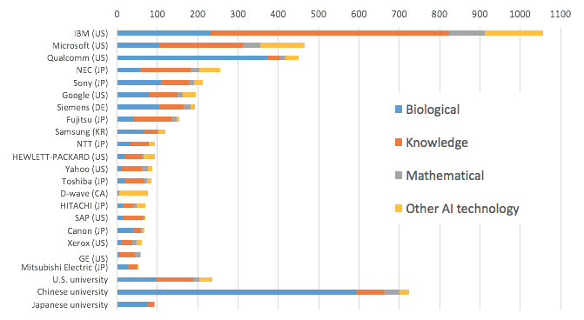
Example grant activity
(G06N 3/#)
(G06N 5/#)
(G06N 7/#)
(G06N 90/00)
Fujii, H, and S Managi (2017),
Trends and Priority Shifts in Artificial Intelligence Technology Invention: A global patent analysis
RIETI Discussion Paper Series 17-E-066.
Notes:
The takeaway message from this graph is the variety; for example, Qualcomm is not traditionally associated with biology-related innovation and yet has a relatively large patent portfolio in this area (c.f., licensing and investing for the future). Similarly for IBM and Microsoft. Consider along with the earlier slide on business awareness, defining markets and the need to invest in order to stay ahead of the competition.
The Cipher report also notes that IBM holds 5x more financial technology (‘fintech’) patents than all the banks put together.

Slide 28
Example grant activity
Fujii, H, and S Managi (2017),
Trends and Priority Shifts in Artificial Intelligence Technology Invention: A global patent analysis
RIETI Discussion Paper Series 17-E-066.
Notes:
The number of patents granted for AI-related inventions has substantially increased over the past decade, with the USPTO being the key driver.
The different growth rates for each technology area is perhaps the more interesting observation from the study, which may reflect changes in R&D strategy among applicants.
Note to self: The study is based on granted patent data from PATENTSCOPE and is ambiguous about family members.

Slide 29
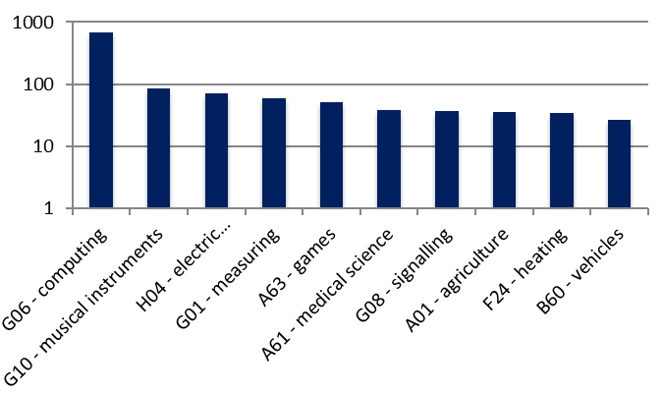
Example International Patent Classifications
Espacenet search ‘artificial intelligence’. First 500 results by date of upload to database.
Notes:
Our own analysis of recent patent applications for AI inventions shows that, aside from first G06 classifications that are arguably unsurprising, the additional classifications cover a broad range of fields with roughly equal significance; a result that , along with the data presented previously, reinforces the message made at the start of this presentation that AI is contributing to innovation and technology development on a broad scale.

Slide 30
Summary
AI has most definitely arrived and will become ubiquitous in every part of the global economy.
Can AI inventions be patented? YES. Clarity, sufficient disclosure and demonstration of a technical solution to a technical problem are key.

Slide 31
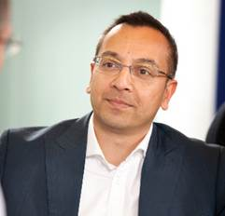
Potter Clarkson LLP
The Belgrave Centre
Talbot Street
Nottingham
NG1 5GG
United Kingdom
T: 0115 955 2211
F: 0115 955 2201
E: info@potterclarkson.com
www.potterclarkson.com
saiful.khan@potterclarkson.com
Nottingham London Copenhagen Lund Stockholm

Slide 32
Useful resources
Cipher IP Strategy Report 2018
European Patent Office CII Guidelines
European Patent Office Patenting Artificial Intelligence
IP Pragmatics Artificial intelligence in the life sciences & patent analytics
Japan Patent Office Examination Guidelines pertinent to IoT Related Technologies
PwC Sizing the prize
World Economic Forum Artificial Intelligence Collides with Patent Law
World Intellectual Property Organization Artificial Intelligence and Intellectual Property

